Slide 1
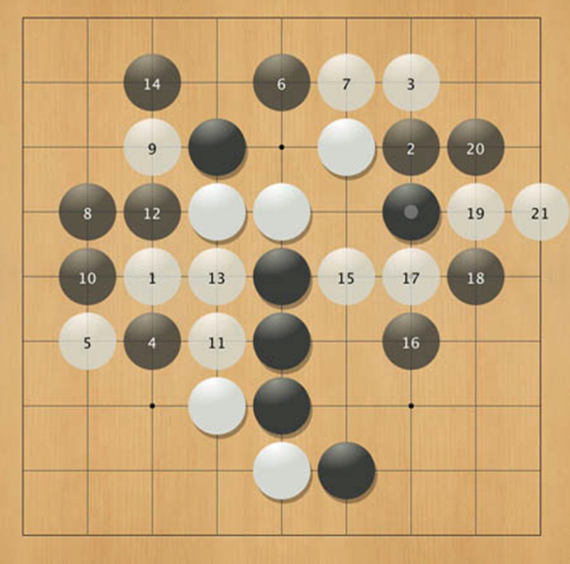
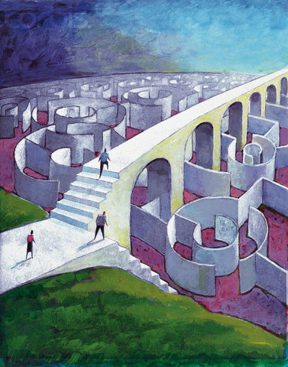
Games Programming
Algorithms & A.I. for Games

Slide 2
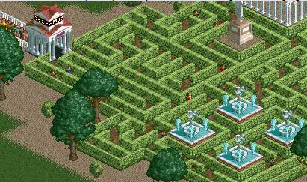
Today’s challenge: generating and solving a maze

Slide 3
Topics
Maze generation
Disjoint Set implementation: up-trees
Optimizations
Solving a maze

Slide 4
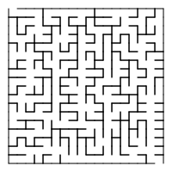
Building a random maze

Slide 5
Build a random maze by erasing edges

Slide 6
Pick Start and End
Start
End

Slide 7
Repeatedly pick random edges to delete
Start
End

Slide 8
Desired Properties
Boundaries cannot be deleted
Every cell reachable from every other cell
no cycles
Start
cycle
End

Slide 9
A Good Solution
Start
End

Slide 10
A Hidden Tree
Start
End

Slide 11
Required data structure: Disjoint Sets
A collection of N sets, in which any two sets contain no common elements (so each element is member of one and only one set)
Example: {3,5,7} , {4,2,8}, {9}, {1,6}

Slide 12
Operations
Find
Union

Slide 13
Find
Each set has a unique name: one of its members
Find(x) – returns the name of the set containing x
Example: {3,5,7,1,6}, {4,2,8}, {9}
Find(1) = 5
Find(4) = 8

Slide 14
Union(x, y)
Takes the union of two sets named x and y
Example: {3,5,7} , {4,2,8}, {9}, {1,6}
Union(5,1) = {3,5,7,1,6}, {4,2,8}, {9}
Union(7,6) = {3,5,7,1,6}, {4,2,8}, {9}

Slide 15
Maze generation algorithm, start
Each cell is in their own set, S ={ {1}, {2}, {3}, {4},… {36} }
All possible edges E ={ (1,2), (1,7), (2,8), (2,3), … } (60 edges in total)
Start
1
2
3
4
5
6
7
8
9
10
11
12
13
14
15
16
17
18
19
20
21
22
23
24
25
26
27
28
29
30
31
32
33
34
35
36
End

Slide 16
Basic Algorithm
S = set of sets of connected cells
E = set of edges
Maze = set of maze edges, initially empty
While there is more than one set in S
pick a random edge (x,y) and remove from E
u = Find(x);
v = Find(y);
if u ≠ v then
Union(u,v)
else
add (x,y) to Maze
All remaining members of E together with Maze form the maze

Slide 17
Example Step
Pick (8,14)
S
{1,2,7,8,9,13,19}
{3}
{4}
{5}
{6}
{10}
{11,17}
{12}
{14,20,26,27}
{15,16,21}
.
.
{22,23,24,29,30,32
33,34,35,36}
Start
1
2
3
4
5
6
7
8
9
10
11
12
13
14
15
16
17
18
19
20
21
22
23
24
25
26
27
28
29
30
31
32
33
34
35
36
End

Slide 18
Example
S
{1,2,7,8,9,13,19}
{3}
{4}
{5}
{6}
{10}
{11,17}
{12}
{14,20,26,27}
{15,16,21}
.
.
{22,23,24,29,39,32
33,34,35,36}
S
{1,2,7,8,9,13,19,14,20 26,27}
{3}
{4}
{5}
{6}
{10}
{11,17}
{12}
{15,16,21}
.
.
{22,23,24,29,39,32
33,34,35,36}
Find(8) = 7
Find(14) = 20
Union(7,20)

Slide 19
Example
Pick (19,20)
S
{1,2,7,8,9,13,19
14,20,26,27}
{3}
{4}
{5}
{6}
{10}
{11,17}
{12}
{15,16,21}
.
.
{22,23,24,29,39,32
33,34,35,36}
Start
1
2
3
4
5
6
7
8
9
10
11
12
13
14
15
16
17
18
19
20
21
22
23
24
25
26
27
28
29
30
31
32
33
34
35
36
End

Slide 20
Example at the End
S
{1,2,3,4,5,6,7,… 36}
Start
1
2
3
4
5
6
7
8
9
10
11
12
E
Maze
13
14
15
16
17
18
19
20
21
22
23
24
25
26
27
28
29
30
31
32
33
34
35
36
End

Slide 21
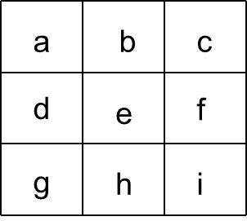
Exercise
Create a maze step-by-step using the following random sequence:
(e, f), (e, h), (a, d), (a,b), (b, e), (d, e), (b, c), (h, i), (f, i), (g, h)

Slide 22
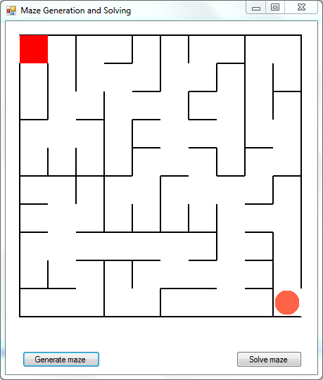
DEMO
maze
generation
program

Slide 23
Disjoint set implementation: Up-tree
Each node has a pointer to its parent
A node can have any number of children
The sets are identified by their root nodes
Disjoint Sets: {A,C,D,E,G,H,J} and {B,F}:
C
B
E
J
F
G
A
H
D

Slide 24
Up-Trees: Array Implementation
Assume: all elems are ints from 0 to N - 1
Represent the up-tree in 1 array of size N
a
-1
2
4
0
-1
2
4
2
6
0
1
2
3
4
5
6
7
8
a[i] = parent of i
a[root] = -1
4
0
2
6
3
1
5
7
8

Slide 25
Exercise find and union
Give the array representation
What is the result of Find(1) and Find(8)?
Draw the result of Union(5, 3)
Give the resulting array representation
5
0
7
8
4
6
3
2
1

Slide 26
Up-Trees: Union
Union(S, T): make the root of one tree point to the tree of the other
Optimization: Union by size (balanced merging strategy)
Always merge the “smaller” tree into the larger one
Prevents linear growth of the height of the tree!

Slide 27
Up-Trees: Union by Size
C
B
E
J
F
G
A
H
D
B
C
C
F
B
E
J
E
J
G
A
H
D
G
A
H
D
F
Incorrect Way
Correct Way

Slide 28
Up-Trees: Array Implementation
Running time: O(1) if we assume S and T are roots, else running time of Find(X)
a
-2
2
4
0
-7
2
4
2
6
0
1
2
3
4
5
6
7
8
a[i] = parent of i
a[root] = -size
4
0
2
6
3
1
5
7
8

Slide 29
Exercise union with optimization
Draw the result of Union(8, 1)
Give the resulting array representation
5
0
7
8
4
6
3
2
1

Slide 30
Exercise Union with optimization
Show the result of the following sequence of instructions:
Union(2,3), union(5,6), union(5,7), union(2,5), union(0,1), union(0,4), union(0,2)
Performed simple
Performed smart (by size)

Slide 31
Up-Trees: Find
Find(X): Follow the pointers up the tree to the root
Takes less time in a shallow, bushy tree than it in a tall, skinny tree
Optimization: Path Compression

Slide 32
Find path compression
After doing a Find, make any node on that path to the root point directly to the root
2
2
-4
2
2
3
-4
2
2
Find(1)
0
1
2
3
0
1
2
3
3
0
2
1
1
3
0

Slide 33
Exercise with path compression
What is the content of the array after Find(7)?
What is the content of the array after Find(8)?
4
2
6
1
5
7
8

Slide 34
Simple Find Implementation
// Find returns the "name" of the set containing
// element
int Find (int element)
{
if ( setArray [element] < 0 )
return element;
else
return Find( setArray [element] );
}

Slide 35
Simple Union Implementation
void Union (int elem1, int elem2)
{
int root1 = Find( elem1 );
int root2 = Find( elem2 );
// set root2 to be child of root1
setArray [root2] = root1;
}

Slide 36
Solving a maze like a human
Left Handed Maze Walking (or Wall Follower)
http://www.youtube.com/watch?v=NA137qGmz4s

Slide 37
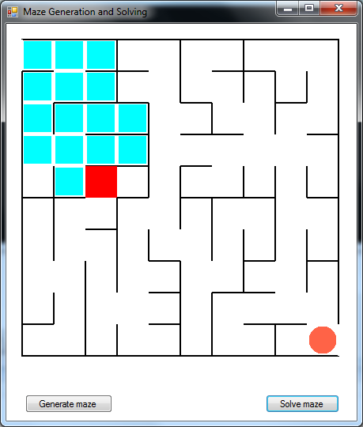
DEMO
solving a maze

